Slide 1

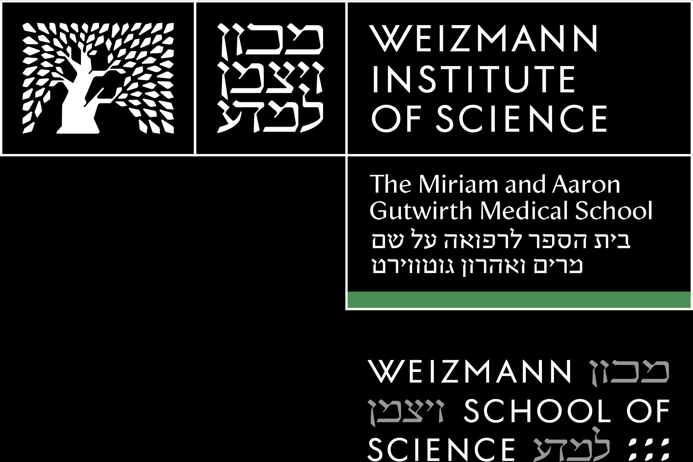
Inside the AI Model
Dr. Amit Shraga
Notes:
הצגה שלי
סקר – שם, כלי AI שהשתמשת בו, לא לחזור על כלי שנאמר כבר. תחילים מהסוף.
מי לא קיבל ועובד עם רישיון מכוני

Slide 2


Session Overview - Empowering Your MD-PhD Journey with AI
1
2
3
AI Fundamentals
Ethics & Responsibilities
Practical Applications
Understanding how AI works at a conceptual level relevant to computational biology
Setting guardrails for responsible AI use in scientific research
Hands-on demonstrations and exercises with relevant tools
Our goal: You'll leave understanding why, when, and how to leverage AI responsibly.
AI in Medicine

Slide 3

PART 1 · 20 MIN
Part 1 — AI Fundamentals
From training data to prediction — the machinery you'll recognize from this morning's reading.
Notes:
Three pieces: the AI/ML/DL/GenAI/LLM landscape (quick taxonomy), how AI tools actually work (brief recap framing, not new teaching), then one live visualizer demo -- CNN Explainer -- chosen specifically because MedGemma (CNN-based) pays it off later in Part 2.

Slide 4
Unpacking the AI Landscape
AI – Artificial Intelligence
Broad field of machines performing human tasks, by learning, reasoning, problem-solving, perception, and decision-making.
ML – Machine Learning
  A subset of AI, the development and study of statistical algorithms that can learn from data and generalize to unseen data, and thus perform tasks without explicit instructions.
Deep Learning
  A subset of ML, deep learning focuses on utilizing multilayered neural networks to perform tasks such as classification, regression
Gen AI
  A subset of DL models that generate contents like text, images, or codes based on provided input.
LLM – Large Language Models
  LLM are ML models that can comprehend and generate human language text
DOI: https://doi.org/10.70389/PJS.100004
AI in Medicine

Slide 5




How AI Tools Actually Work
Training Data
Neural Networks
Prediction
Billions of texts, papers,
code samples, and websites
Like signal transduction pathways, information flows through interconnected layers
Probabilistic predictions based on statistical patterns, not "thinking"
Important: AI can hallucinate false information and references with confidence, especially with scientific content.
AI in Medicine

Slide 6
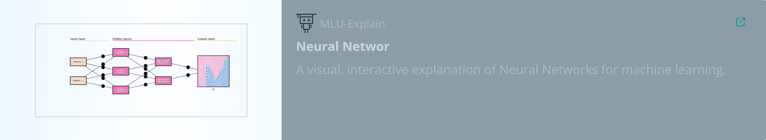
Neural networks
AI in Medicine

Slide 7

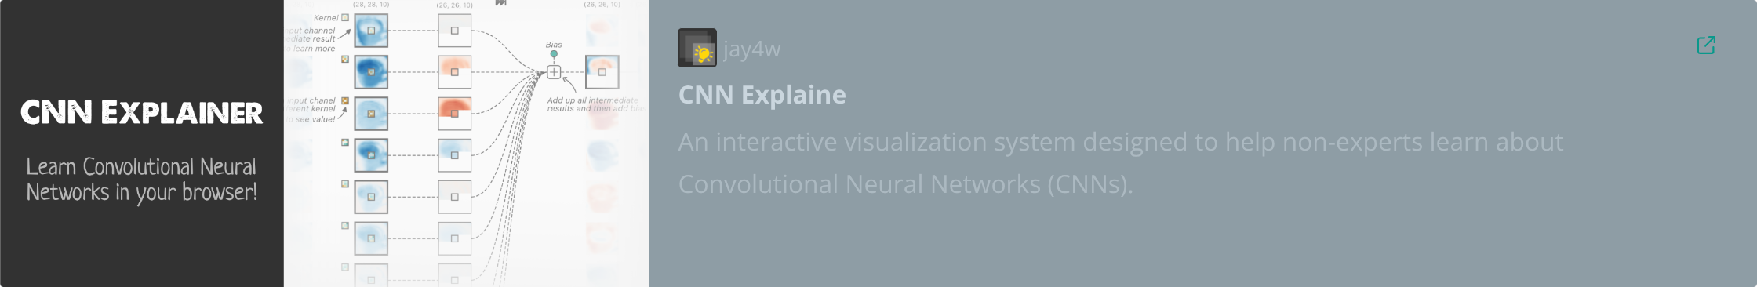
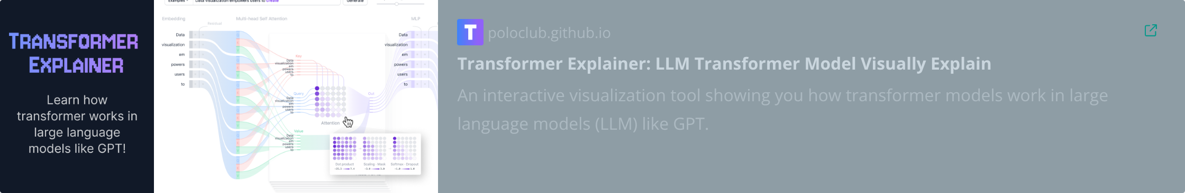

Visualization tools
AI in Medicine

Slide 8
PART 2 · 20 MIN
Part 2 — Ethics & Responsibilities
Setting guardrails for responsible AI use in scientific research and medicine.

Slide 9




AI in Medical Applications
Medical Imaging Analysis
Drug Discovery & Development
AI algorithms are used to interpret scans (X-rays, MRIs, CTs) for faster and more accurate detection of anomalies and diseases.
AI accelerates the identification of potential drug candidates, predicts their efficacy, and optimizes development processes.
Clinical Decision Support
Surgical Assistance & Robotics
AI can assist in diagnosis, treatment planning, and personalized medicine by analyzing patient data and medical literature.
AI guides robotic systems in performing precise surgical procedures, enhancing accuracy and patient outcomes.
2
3
1
4
AI in Medicine

Slide 10
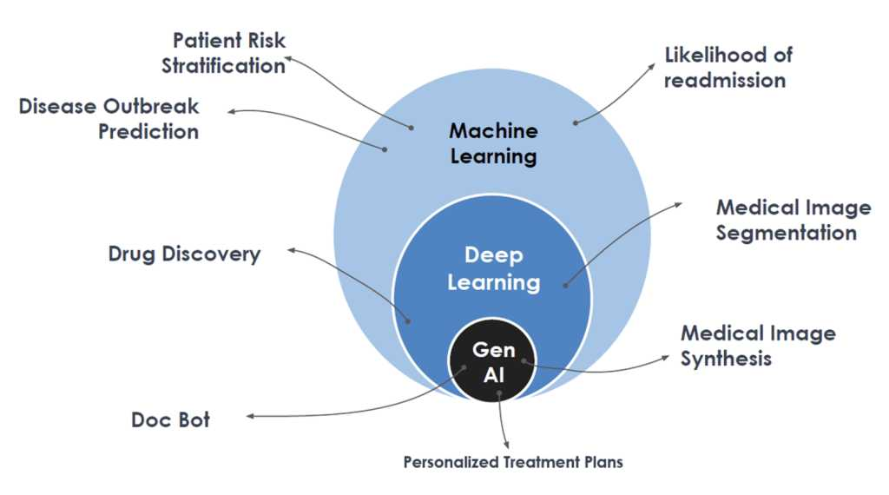
AI in Medical Applications
Medical Imaging Analysis
Drug Discovery & Development
AI algorithms are used to interpret scans (X-rays, MRIs, CTs) for faster and more accurate detection of anomalies and diseases.
AI accelerates the identification of potential drug candidates, predicts their efficacy, and optimizes development processes.
Clinical Decision Support
Surgical Assistance & Robotics
AI can assist in diagnosis, treatment planning, and personalized medicine by analyzing patient data and medical literature.
AI guides robotic systems in performing precise surgical procedures, enhancing accuracy and patient outcomes.
2
3
https://premierscience.com/pjs-24-266/
1
4
AI in Medicine

Slide 11

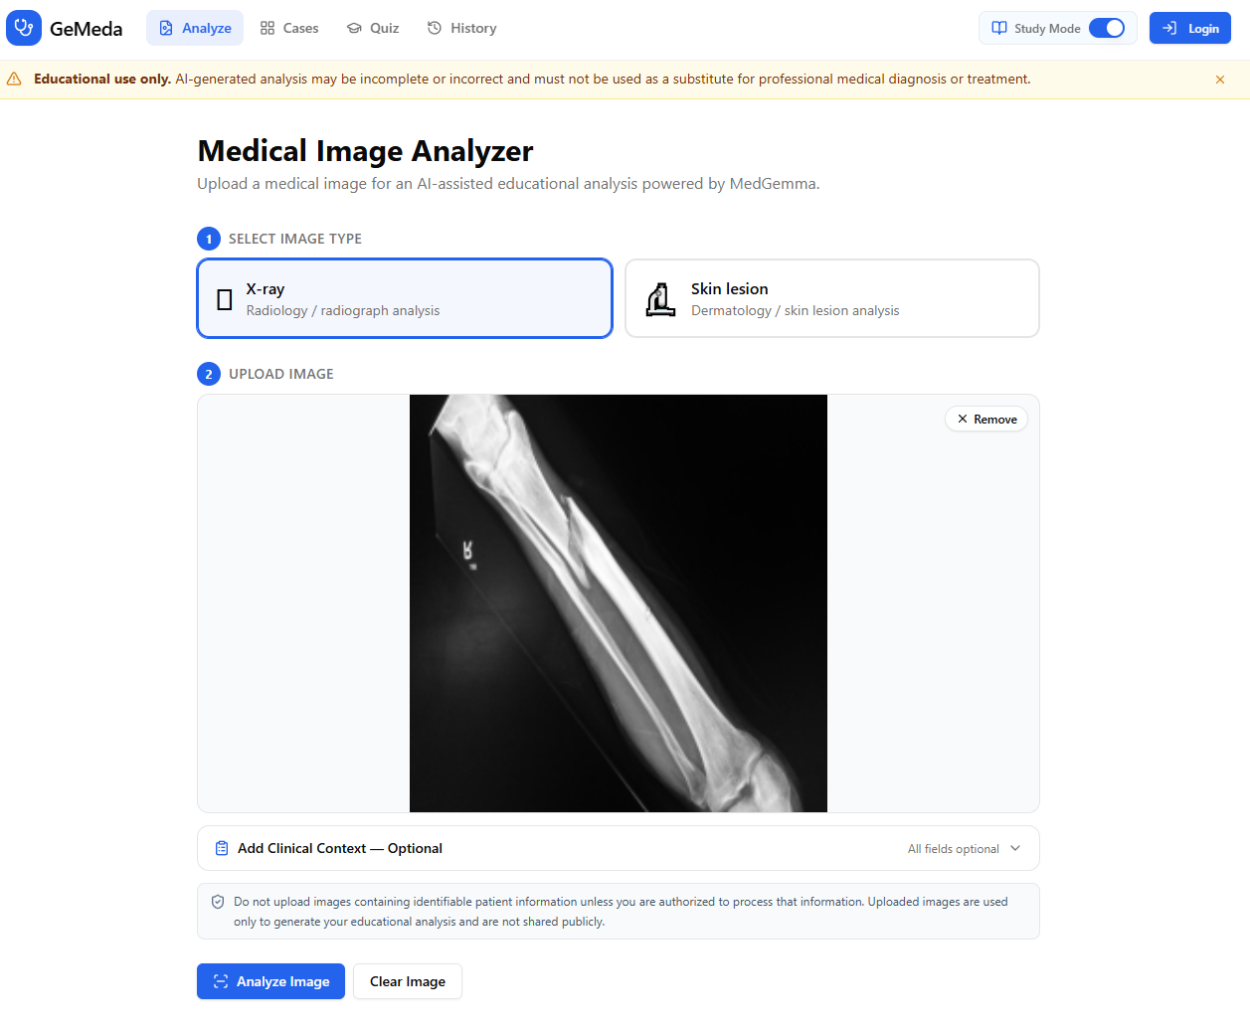

MedGemma
Medical image classification including radiology, digital pathology and skin images.
Medical image interpretation, generating medical image reports
Text-based medical question answering; patient preclinical interviews, triaging, clinical decision support, and summarization.
AI in Medicine

Slide 12

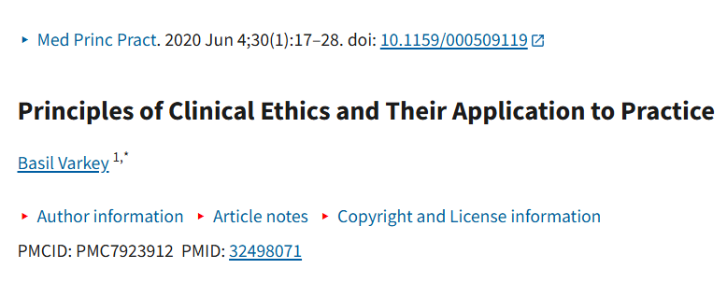
The Physician-Scientist's Ethical Framework
Key Ethical Considerations
Privacy: Never input patient data
Academic integrity: Cite AI use appropriately
Bias awareness: AI trained primarily on Western data
Verification: Validate sources, Cross-check against peer-reviewed sources
Transparency: Be open about AI's role in your work
Group discussion point:
How might AI tools introduce bias into medical research?
https://pmc.ncbi.nlm.nih.gov/articles/PMC7923912/
AI in Medicine

Slide 13
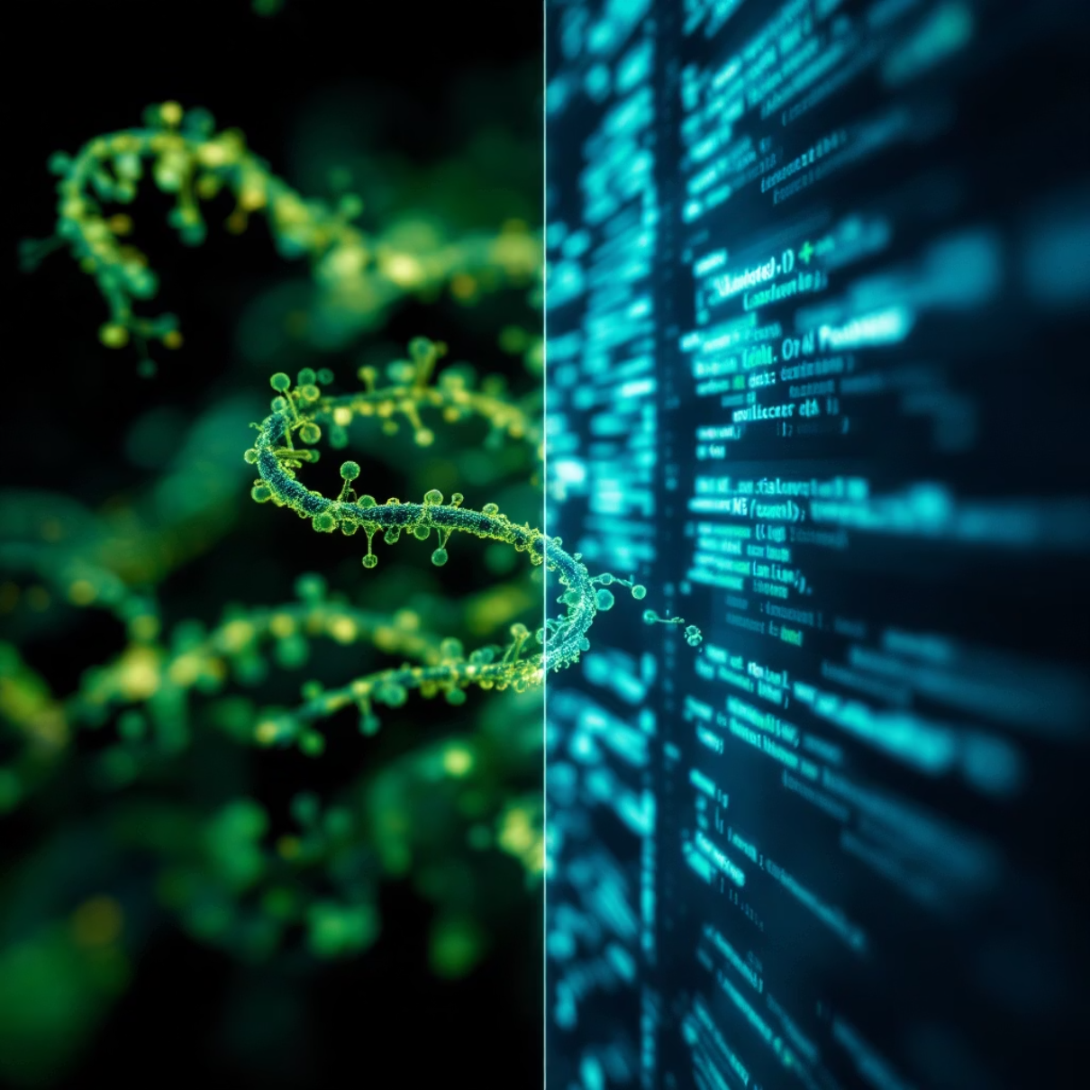
AI in the Computational Biology Context
AI tools can accelerate your learning and research across multiple areas of the CMBC curriculum:
Code generation and debugging for RNA-seq analysis pipelines
Explaining complex concepts like protein structure prediction
Literature search and synthesis for hypothesis generation
Troubleshooting statistical analyses and visualizations
But remember: AI is a tool to augment your expertise, not replace critical thinking or domain knowledge.
AI in Medicine

Slide 14
Expectations for Appropriate AI Use
Appropriate Uses
Inappropriate Uses
Brainstorming research questions
Submitting AI-generated work without review
Generating or debugging code
Using code you don't understand
Explaining complex statistical concepts
Relying on AI for definitive scientific facts
Literature summarization (with verification)
Bypassing the learning process
Failing to cite AI contributions
Golden rule: You are responsible for all outputs.
Treat AI as a collaborator whose work you must verify, understand, and be able to defend.
AI in Medicine

Slide 15
PART 3 · 40 MIN
Part 3 — Practical Applications
Prompting strategies, real tools, and what's ahead this afternoon.

Slide 16






Effective Prompting Strategies
Task
Clearly define what you want the AI to do.
Context
Provide background information and relevant details.
Format
Specify the desired output structure.
AI in Medicine

Slide 17

Practical Demo: AI for Computational Biology
Example Prompts We'll Explore Together
Context, Task, Format
"Provide a step-by-step guide for using AlphaFold 3 to model the LCT gene mutation (e.g., C/T-13910) associated with lactase persistence, focusing on structural impacts like altered binding or stability. Include commands or settings for ColabFold, and suggest specific methods to validate predictions against experimental data (e.g., PDB entries or literature). Highlight how structural differences might vary across populations with high (e.g., Northern Europe) vs. low (e.g., East Asia) mutation prevalence"
AI in Medicine

Slide 18
Practical Demo: AI for Computational Biology
Example Prompts We'll Explore Together
Context, Task, Format
“Provide a step-by-step guide for using AlphaFold 3 to model the LCT gene mutation (e.g., C/T-13910) associated with lactase persistence, focusing on structural impacts like altered binding or stability. Include commands or settings for ColabFold, and suggest specific methods to validate predictions against experimental data (e.g., PDB entries or literature). Highlight how structural differences might vary across populations with high (e.g., Northern Europe) vs. low (e.g., East Asia) mutation prevalence”
AI in Medicine

Slide 19
Practical Demo: AI for Computational Biology
Example Prompts We'll Explore Together
2. "What are the main mutations in the CFTR gene for Cystic Fibrosis? How common are they worldwide compared to Israel? Give sources"
AI in Medicine

Slide 20
Practical Demo: AI for Computational Biology
Example Prompts We'll Explore Together
2. "Summarize the most prevalent CFTR gene mutations causing Cystic Fibrosis, and compare their allele frequencies in global populations versus in Israel, noting Ashkenazi Jewish-specific variants if applicable. Cite primary sources like ClinVar, gnomAD, or peer-reviewed studies, and highlight any limitations in population data (e.g., sampling biases). Include a summary table"
AI in Medicine

Slide 21
Effective Prompting Strategies
Be Specific
Use Step-by-Step Requests
Include relevant context: "As an MD-PhD student analyzing RNA-seq data from cancer samples..."
"First explain the concept, then show the code, finally explain each line"
Request Verification Steps
Iterate & Refine
"Suggest how I can validate these results using statistical tests"
"That's too complex. Simplify the explanation and focus on [specific aspect]"
Remember: The quality of your output depends heavily on the quality of your input!
AI in Medicine

Slide 22
TOOL LANDSCAPE
~5 min
Beyond ChatGPT: The Wider Toolkit
Chat Models
ChatGPT · Gemini · Claude · Grok · Perplexity
Creative & Slides
Canva AI · Gemma AI · DALL·E · Midjourney
Productivity
Co-Pilot (Excel data analysis) · Sumit (meeting notes, transcripts — Hebrew-capable)
Perplexity, OpenEvidence, and QED Science get hands-on treatment this afternoon — the rest here are worth knowing exist.
Notes:
Fast tour, ~5 min -- this is 'know these exist' territory, not hands-on. The tools you'll actually use hands-on this afternoon (Perplexity, OpenEvidence, QED) get their own deep dive in the workshop, so don't over-invest time here.

Slide 23
TOOL LANDSCAPE
Deep Research, NotebookLM & RAG
Deep Research tools like Undermind and Perplexity use NLP to navigate vast academic literature
Caution: evaluations show only about a quarter of bibliographic references are fully accurate — verify everything
NotebookLM: summarizing, quizzes, cross-referencing, drafting literature reviews from your own sources
RAG — Retrieval-Augmented Generation
The technique behind grounded tools: a model looks up relevant external documents before generating its answer, instead of relying only on what it memorized during training.
This is exactly the mechanism behind the MCP demo you just saw — and behind Perplexity/OpenEvidence, which you'll use directly this afternoon.
Notes:
The accuracy caveat on Deep Research tools is worth landing clearly -- it's a real, citable evaluation finding, not a vague warning, and it directly previews the workshop's citation-verification exercise.

Slide 24
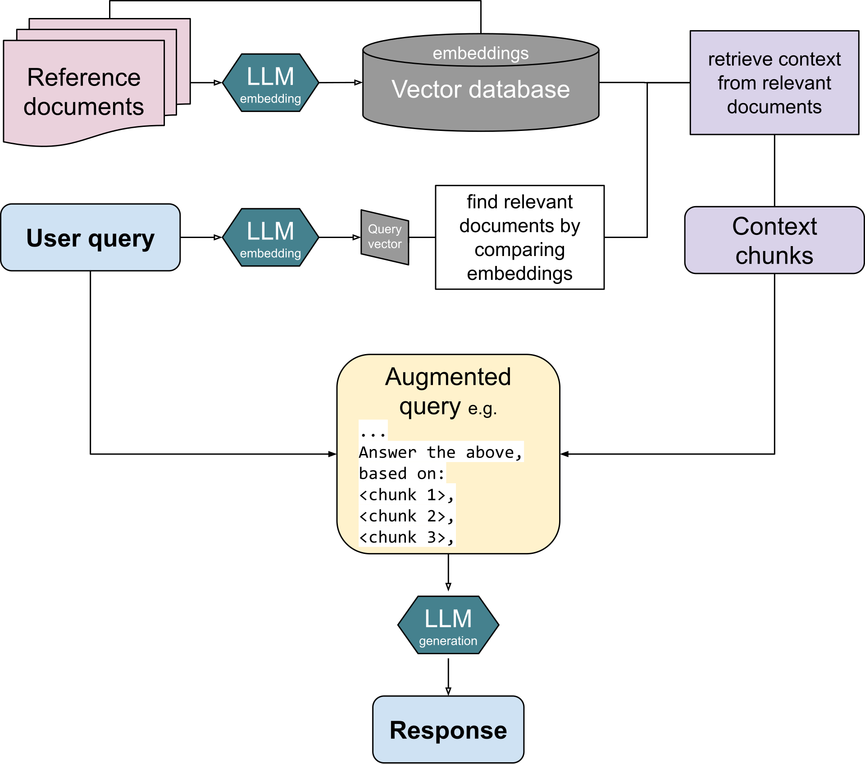
Retrieval-Augmented Generation
Retrieval-Augmented Generation (RAG) is the process of optimizing the output of a large language model, so it references an authoritative knowledge base outside of its training data sources before generating a response.
https://en.wikipedia.org/wiki/Retrieval-augmented_generation#/media/File:RAG_diagram.svg
AI in Medicine

Slide 25
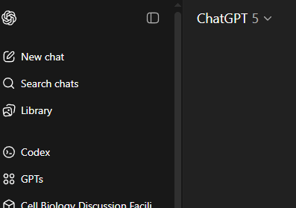
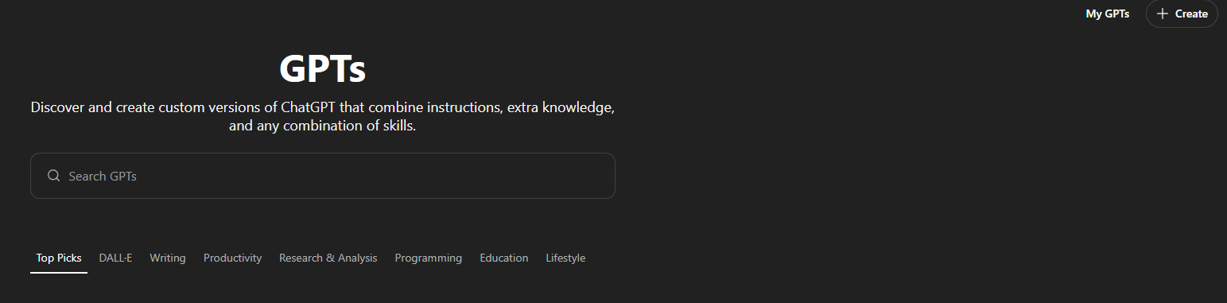
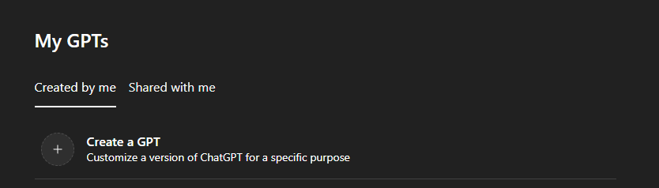
Chatbot – based on myGPT
1
2
3
AI in Medicine

Slide 26
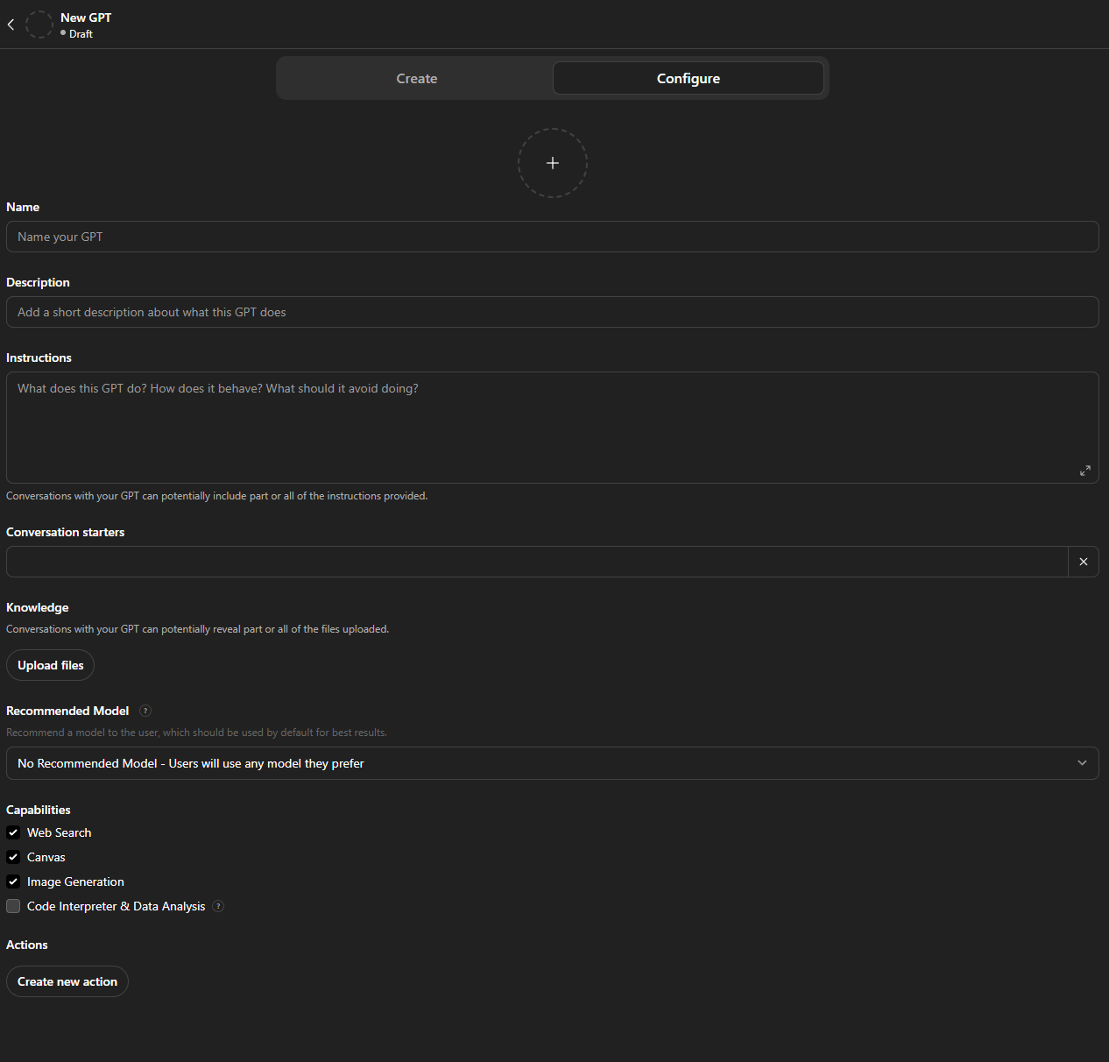
4
Chatbot – based on myGPT
Define the Purpose
What problem does the bot solve?
Who is the target audience?
Design the Personality
Choose tone (formal, friendly, playful, etc.).
Set traits, values, and limitations.
Structure the Prompts
Write clear instructions for behavior.
Use templates with [variables] for flexibility.
Add Knowledge & Context
Provide examples, FAQs, or reference docs.
Establish how the bot should treat the user.
Test Conversations
Generate sample dialogues.
Adjust style, depth, and accuracy.
Refine & Iterate
Trim filler, rewrite unclear parts.
Tune settings (temperature, top-p) for personality.
AI in Medicine

Slide 27
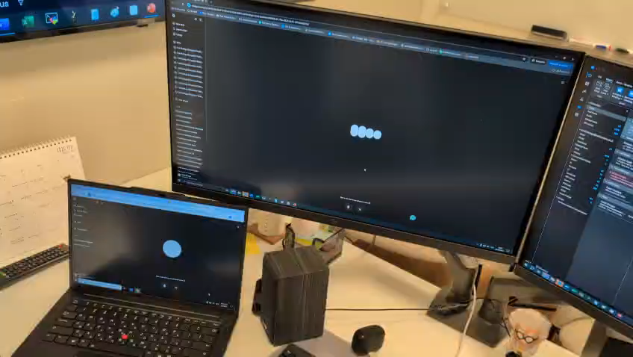
AI trains AI
AI in Medicine

Slide 28
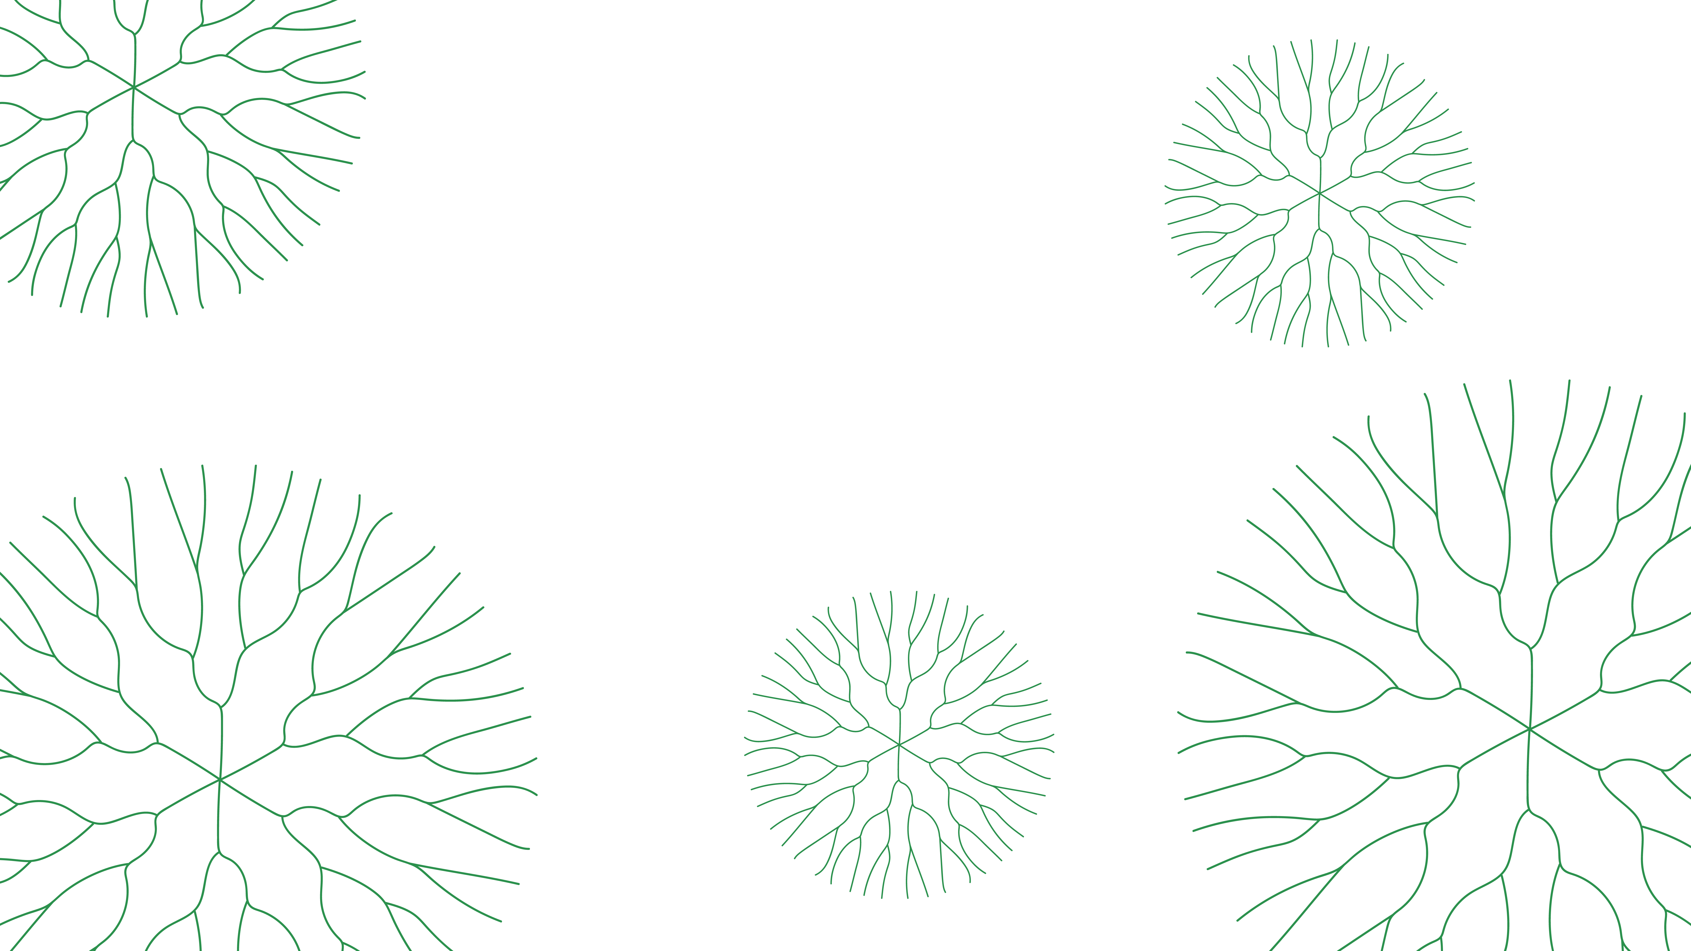

Thank you!

